Slide 1

GPT-2: Qu’ils mangent de la brioche (let them eat cake)
Data Science to Patient Value (D2V)
UNIVERSITY OF COLORADO ANSCHUTZ MEDICAL CAMPUS
March 2019 – Seth Russell, ms
Notes:
Today, I’m going to talk about the paper “Language Models are Unsupervised Multitask Learners”
Rather than making that the title of my presentation, I’ve instead chosen the famous French saying:
Kill manj de la bri-osh – which is “let them eat cake” in English. That phrase gives you some idea of what I think of the paper.
https://www.history.com/news/did-marie-antoinette-really-say-let-them-eat-cake

Slide 2
Overview
What is Natural Language Processing
Transfer learning in Natural Language Processing
Language Modeling
Transformer (no, not the robots!)
Experiments/Results
Reproducibility/Replicability
Demo
Now what?
Data Science to Patient Value (D2V)
UNIVERSITY OF COLORADO ANSCHUTZ MEDICAL CAMPUS
Notes:
For item 1 – I want to make sure we’re all on the same page – we’ve talked briefly in previous Machine Learning reading groups about NLP, but haven’t really covered in detail what I consider required background knowledge on the subject.
<click>
By building a general purpose language model, GPT-2 is creating a model that can work well in many situations; This is different from multi-task learning.
<click>
I’ll talk about what language modeling is
<click>
GPT-2 is built on the Transformer network architecture.
<click>
Next, I’ll cover some of the experiments and results achieved with GPT-2
<click>
Then, I’ll talk about some of the limitations of this work
<click>
Time permitting, I’ll show a brief demo of the GPT-2 version that is available to others
<click>
And then my conclusions

Slide 3
What is Natural Language Processing?
What is the study of language?
LINGUISTICS
Computer system that analyzes or synthesizes spoken or written human language
Document categorization
Document clustering
Entity extraction
Entity resolution
Data Science to Patient Value (D2V)
UNIVERSITY OF COLORADO ANSCHUTZ MEDICAL CAMPUS
Notes:
What is the study of language <click>
Linguistics is the scientific study of language. It involves analyzing language form, language meaning, and language in context.
Linguists traditionally analyze human language by observing an interplay between sound and meaning.[6] Phonetics is the study of speech and non-speech sounds, and delves into their acoustic and articulatory properties. The study of language meaning, on the other hand, deals with how languages encode relations between entities, properties, and other aspects of the world to convey, process, and assign meaning, as well as manage and resolve ambiguity.
<click>
So, NLP is the translation of Linguistics to computers
<click>
Some comment tasks to be accomplished in the realm of NLP are: <click>

Slide 4
What is Natural Language Processing
Syntax: a set of rules for a language
Semantics: the meaning of a word, phrase, sentence or text
Context: the parts of something written or spoken that immediately precede and follow a word or passage and clarify its meaning
Morphology: study of the internal structure of words. Stemming comes from this.
hopped -> hop
hopping -> hop
Tokenization: chopping text into a sequence of characters that are grouped together as a useful semantic unit for processing
Colorless green ideas sleep furiously
Data Science to Patient Value (D2V)
UNIVERSITY OF COLORADO ANSCHUTZ MEDICAL CAMPUS
Notes:
Some common terms used in NLP and what they mean.
An example sentence to demonstrate how syntax and semanitics can be at odds with eachother. Context of this sentence is Noam Chomsky – famous linguist

Slide 5
Evolution of Natural Language Processing
Linguistic approach: Top-Down symbolic approach focusing on syntax, semantics
Statistical approach: Bottom-Up focus on associations and probabilities.
Change of focus from linguistic theory to reliance upon corpus statistics
Modern machines can process millions of documents by computing billions of calculations to build statistical profiles from large corpora
Data Science to Patient Value (D2V)
UNIVERSITY OF COLORADO ANSCHUTZ MEDICAL CAMPUS
Notes:
Two approaches
In my experience, most of the early NLP leaders were linguists; the trend over the last 15 – 20 years has been statistics. Frequently today you’ll see excellent NLP work being done by those with no linguistic experience nor education.
Second approach gaining more traction recently due to increased computational power and deep learning techniques (universal approximation theorem)

Slide 6
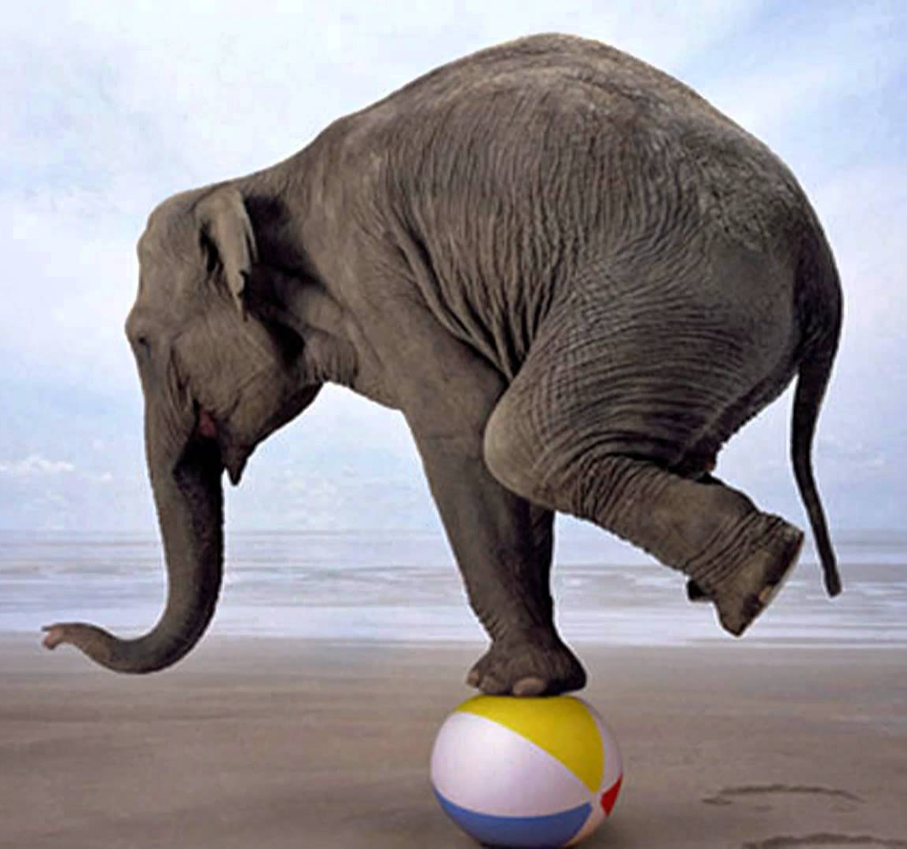


Current Problems in NLP
Data Science to Patient Value (D2V)
UNIVERSITY OF COLORADO ANSCHUTZ MEDICAL CAMPUS
Notes:
CURRENT PROBLEMS IN NLP. ACTUALLY THE SAME CAN BE SAID OF ALL MACHINE LEARNING.
Current Machine learning systems are brittle and sensitive to slight changes in the data.
<click>
A they’re like this elephant balanced on one foot. Any slight breeze will make it all fall over.
<click>
Furthermore, the common approach is to do single task training on a single domain data set – similar to this shape ball you may have played with as a child or have for your child. Each shape only fits in one hole. This approach means every single problem requires a unique solution.

Slide 7
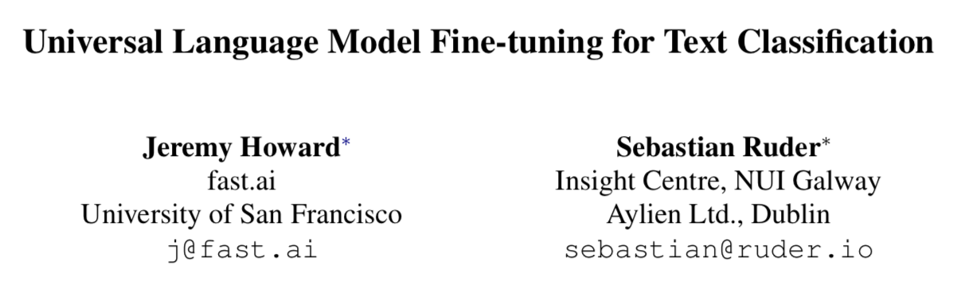
NLP Transfer Learning
Natural language processing tasks, such as question answering, machine translation, reading comprehension, and summarization, are typically approached with supervised learning on task-specific datasets. We demonstrate that language models begin to learn these tasks without any explicit supervision when trained …
Data Science to Patient Value (D2V)
UNIVERSITY OF COLORADO ANSCHUTZ MEDICAL CAMPUS
Notes:
From the abstract of the GPT-2 Paper:
We have actually discussed this at a previous reading group session about 9 months ago. As I recall there were only a handful of us there.
In my opinion, this GPT-2 paper is an example of replication from the ULMFit paper. Radford et al have shown that a general model can provide an excellent starting point for a specific problem. Radford calls what they are doing ‘pre-training’ but it seems to be to be identical to what most others call transfer learning.
By replication I mean: "the chance that an independent experiment targeting the same scientific question will produce a consistent result."

Slide 8
Universal Language Model
Works across asks varying in document size, number, and label type
Uses a single architecture and training process
Requires no custom feature engineering nor preprocessing
Does not require additional in-domain documents or labels
Data Science to Patient Value (D2V)
UNIVERSITY OF COLORADO ANSCHUTZ MEDICAL CAMPUS
Notes:
ULMFit has some useful definitions that are relevant here as well. By the term Universal they mean specifically:

Slide 9
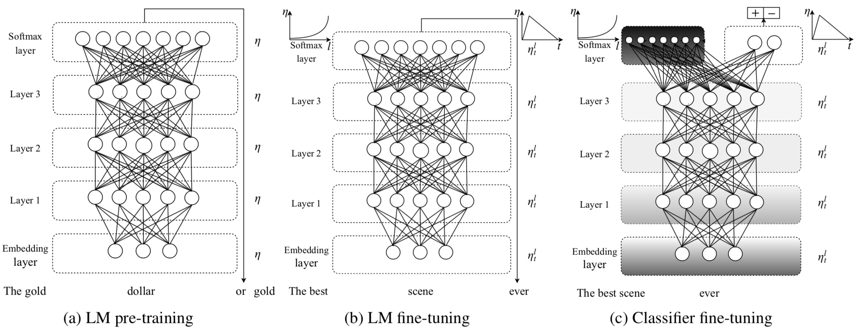
ULMFiT
Howard J, Ruder S. Universal Language Model Fine-tuning for Text Classification. arXiv:180106146 [cs, stat]. 2018 Jan 18; Available from: http://arxiv.org/abs/1801.06146
Data Science to Patient Value (D2V)
UNIVERSITY OF COLORADO ANSCHUTZ MEDICAL CAMPUS
Notes:
There are a few points from the ULMFit paper that I want to bring up as it is relevant here.
They are using the Average Stochastic Gradient Descent Weight-Dropped LSTM (AWD-LSTM) network architecture
Figure 1: ULMFiT consists of three stages: a) The LM is trained on a general-domain corpus to capture general features of the language in different layers. b) The full LM is fine-tuned on target task data using discriminative fine-tuning (‘Discr’) and slanted triangular learning rates (STLR) to learn task-specific features. c) The classifier is fine-tuned on the target task using gradual unfreezing, ‘Discr’, and STLR to preserve low-level representations and adapt high-level ones (shaded: unfreezing stages; black: frozen).

Slide 10
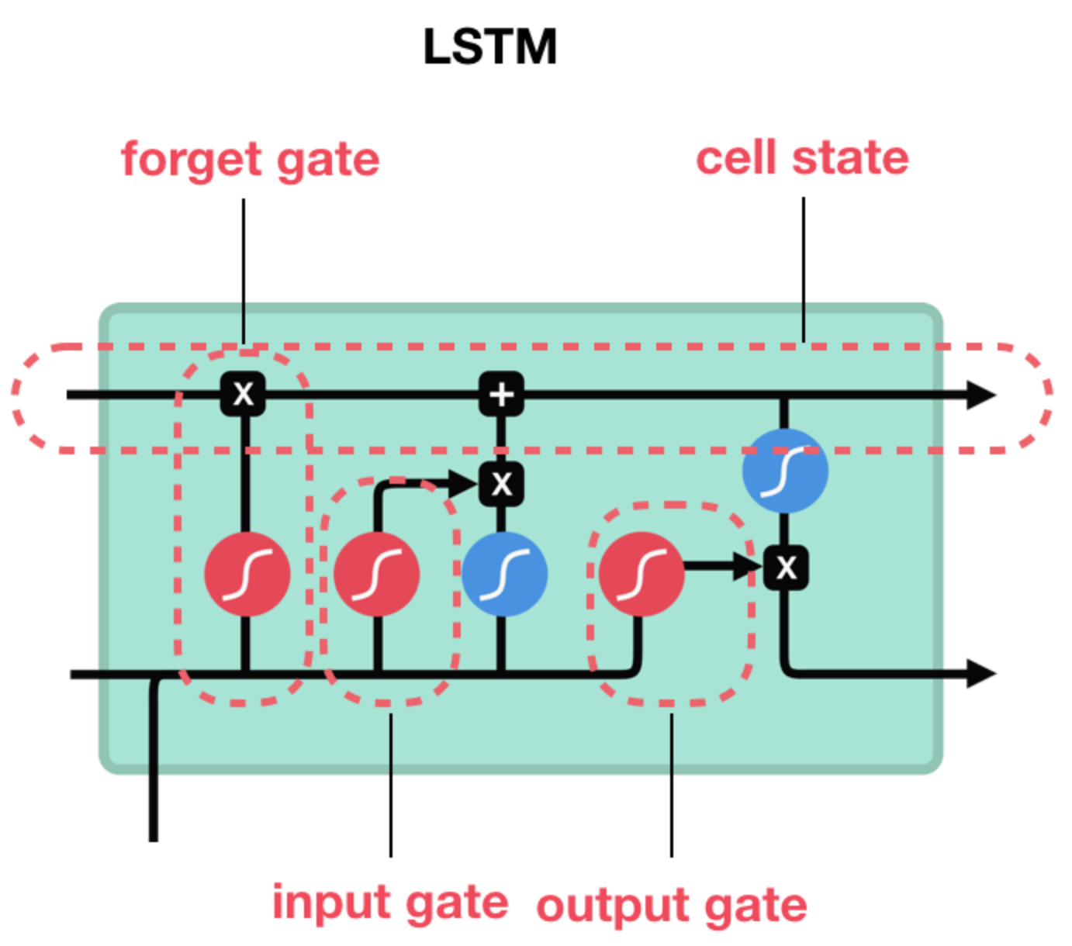
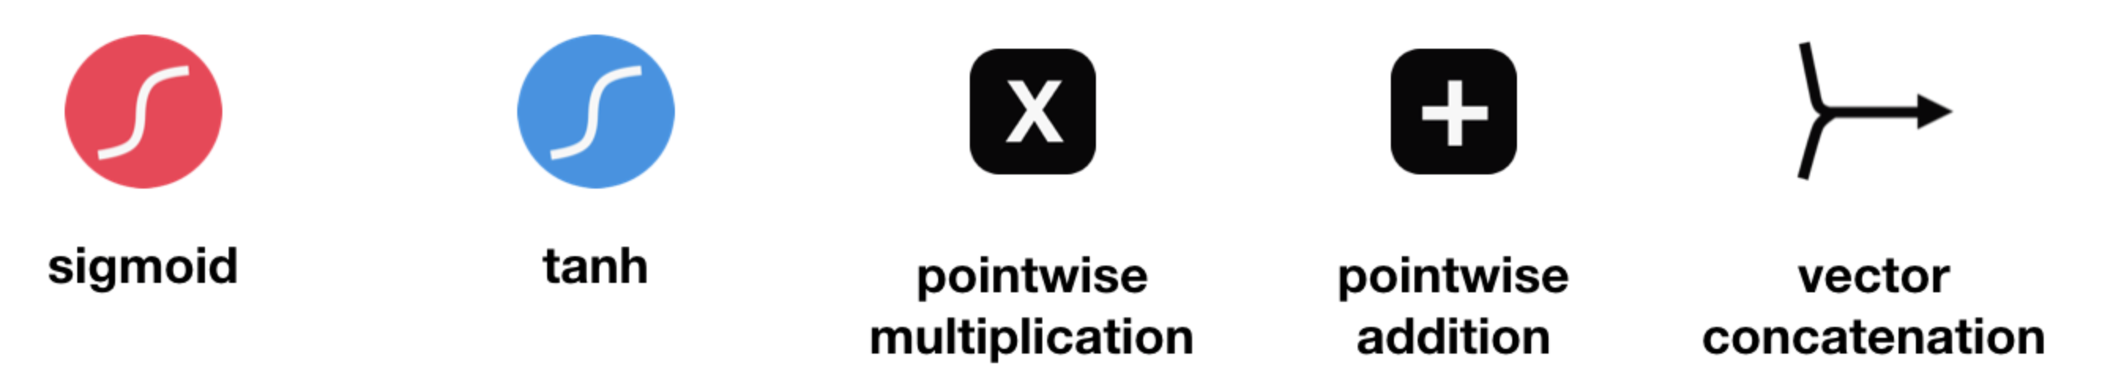
Long Short Term Memory
https://towardsdatascience.com/illustrated-guide-to-lstms-and-gru-s-a-step-by-step-explanation-44e9eb85bf21
Data Science to Patient Value (D2V)
UNIVERSITY OF COLORADO ANSCHUTZ MEDICAL CAMPUS

Slide 11
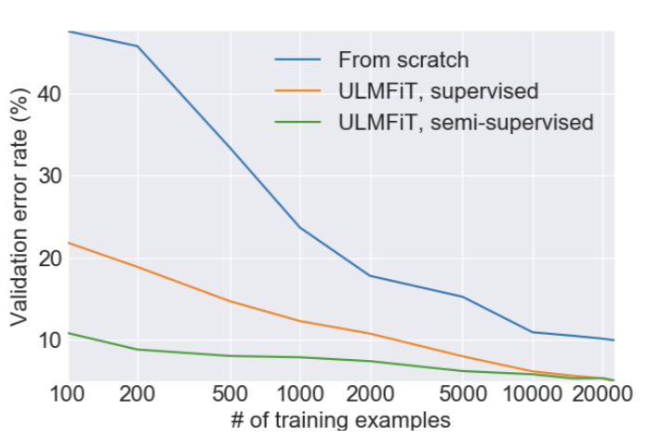
ULMFiT
Data Science to Patient Value (D2V)
UNIVERSITY OF COLORADO ANSCHUTZ MEDICAL CAMPUS
Notes:
Figure 1: ULMFiT consists of three stages: a) The LM is trained on a general-domain corpus to capture general features of the language in different layers. b) The full LM is fine-tuned on target task data using discriminative fine-tuning (‘Discr’) and slanted triangular learning rates (STLR) to learn task-specific features. c) The classifier is fine-tuned on the target task using gradual unfreezing, ‘Discr’, and STLR to preserve low-level representations and adapt high-level ones (shaded: unfreezing stages; black: frozen).
this topic interests you, you may want to dig up the ULMFit Paper by Howard and Ruder.

Slide 12
So what?
“We demonstrate language models can perform down-stream tasks in a zero-shot setting – without any parameter or architecture modification.“
Data Science to Patient Value (D2V)
UNIVERSITY OF COLORADO ANSCHUTZ MEDICAL CAMPUS
Notes:
So how good is this transfer learning approach?
Radford says “We demonstrate language models can perform down-stream tasks in a zero-shot setting.- without any parameter or architecture modification.
What is Zero-shot learning?

Slide 13
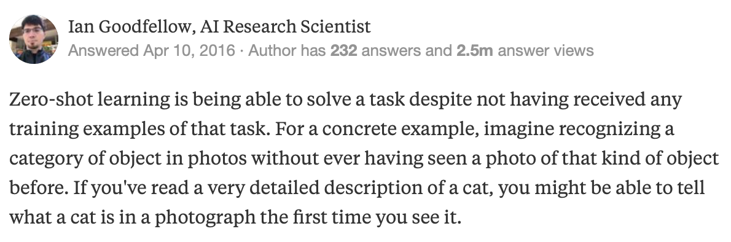
Zero Shot Learning
“While suggestive as a research result, in terms of practical applications, the zero-shot performance of GPT-2 is still far from use-able.”
Data Science to Patient Value (D2V)
UNIVERSITY OF COLORADO ANSCHUTZ MEDICAL CAMPUS
Notes:
Here’s a short quote from a guy some of you may have heard of:
<click>
Read quote
Sounds great doesn’t it?
Unfortunately, GPT-2 doesn’t actually work in a real zero-shot setting according to the authors:
<click>

Slide 14
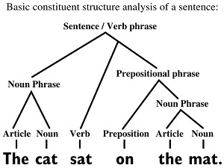
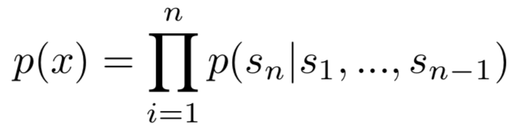
Language Modeling
Linguistic Approach
Statistics Approach
Data Science to Patient Value (D2V)
UNIVERSITY OF COLORADO ANSCHUTZ MEDICAL CAMPUS
Notes:
In terms of the English language, when we write, we create sentences according to specific rules. Spoken language is more dynamic and has rules that change more rapidly.
<click to show sentence structure>
As an example, a sentence can be broken down into specific parts – some of which are required and some are not.
<click to show formula>
In the mathematical sense, language modeling is usually framed as unsupervised distribution estimation from a set of examples (x1, x2, ..., xn) each composed of variable length sequences of symbols (s1, s2, ..., sn). The probability of an example sentence occurring is the product of the sequence from 1 to n of the probability of a specific symbol given the symbols that come before it.
Listed as formula 1 in the paper.

Slide 15
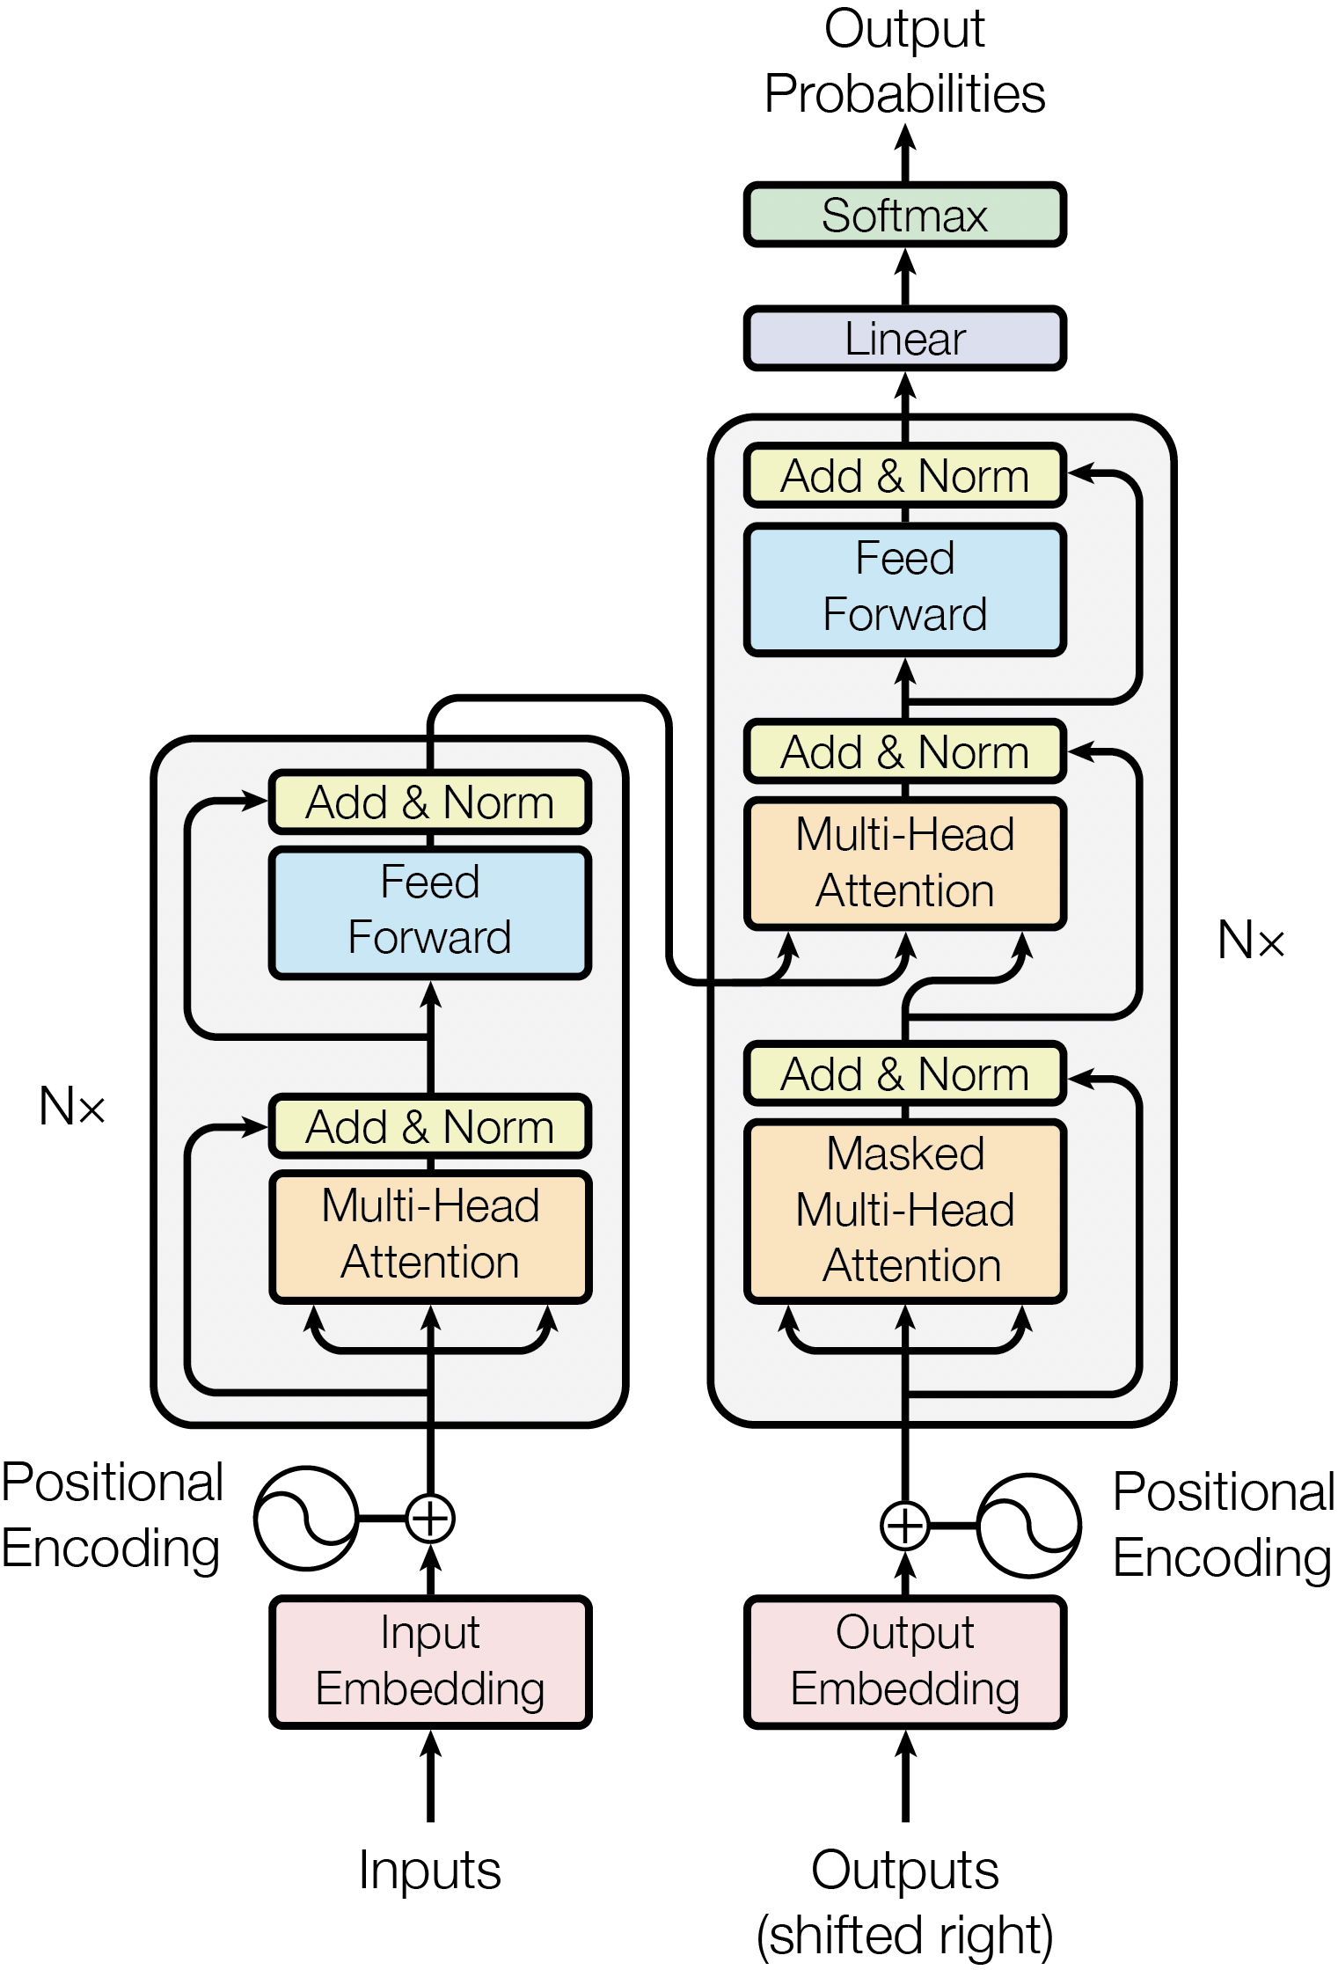
“Attention is all you need”
Transformer Architecture
Vaswani A, Shazeer N, Parmar N, Uszkoreit J, Jones L, Gomez AN, et al. Attention Is All You Need. arXiv:170603762 [cs] [Internet]. 2017 Jun 12 [cited 2019 Mar 13]; Available from: http://arxiv.org/abs/1706.03762
Data Science to Patient Value (D2V)
UNIVERSITY OF COLORADO ANSCHUTZ MEDICAL CAMPUS
Notes:
2017: Attention is all you need
recurrent or convolutional neural networks include an encoder and a decoder. The best performing models also connect the encoder and decoder through an attention mechanism. We propose a new simple network architecture, the Transformer, based solely on attention mechanisms, dispensing with recurrence and convolutions entirely. Experiments on two machine translation tasks show these models to be superior in quality while being more parallelizable and requiring significantly less time to train. While LSTMs have been doing well in the NLP space as shown by ULMFit and others, it appears that the Transformer/attention based network architecture is superior in that it better captures the long-range dependencies of text as compared to LSTMs or GRUs.

Slide 16
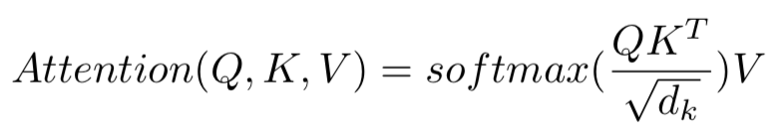
Transformer Evolution
Liu PJ, Saleh M, Pot E, Goodrich B, Sepassi R, Kaiser L, et al. Generating Wikipedia by Summarizing Long Sequences. arXiv:180110198 [cs]. 2018 Jan 30; Available from: http://arxiv.org/abs/1801.10198
Data Science to Patient Value (D2V)
UNIVERSITY OF COLORADO ANSCHUTZ MEDICAL CAMPUS
Notes:
From the original transformer paper, this is called “Scaled Dot-Product Attention”; The attention is a function of a query (Q) and set of key (K) and value (V ) pairs, all of which are vectors. A set of queries are combined into Q and multiplied by by all keys (matrix multiplication) then dvicided by the square root of D sub k (dk) where D sub k is the dimension of the keys. Then the softmax of that is multiplied by the values.
softmax function, is a function that takes as input a vector of K real numbers, and normalizes it into a probability distribution consisting of K probabilities.
To handle longer sequences, we modify the multi-head self-attention of the Transformer to reduce memory usage by limiting the dot products between Q and K in:

Slide 17
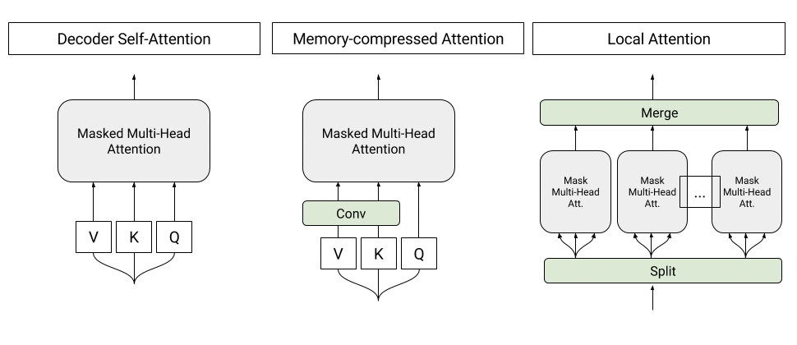
Transformer Evolution
Data Science to Patient Value (D2V)
UNIVERSITY OF COLORADO ANSCHUTZ MEDICAL CAMPUS
Notes:
query (Q) and set of key (K) and value (V ) pairs.
2018: Taking work from Vaswani and building on it. Liu says “We introduce a simple but effective modification to Transformer Encoder Decoder for long sequences that drops the encoder module (almost reducing model parameters by half for a given hyper-parameter set), combines the input and output sequences into a single ”sentence” and is trained as a standard language model. “
Local attention: Sequence tokens are divided into blocks of similar length and attention is per- formed in each block independently. As the attention memory cost per block becomes constant, this modification allow us to keep the number of activations linear with respect to the sequence length. In our experiments, we choose to have blocks of 256 tokens.
Memory-compressed attention: After projecting the tokens into the query, key, and value embed- dings, we reduce the number of keys and values by using a strided convolution. The number of queries remains unchanged. This modification allows us to divide the number of activations by a compression factor. In our experiments we use convolution kernels of size 3 with stride 3. In con- trast to local attention layers, which only capture the local information within a block, the memory- compressed attention layers are able to exchange information globally on the entire sequence.
These modifications (see Figure 1) allow us in practice to process sequences 3x in length over the T-D model. For both local and memory-compressed attention, masking is added to prevent the queries from attending to future keys and values. Our final architecture is a 5-layer network (LMLML) alternating between local-attention (L) layers and memory-compressed attention (M) layers (in Vaswani et al. (2017) it is 6 identical layers). We also added in some experiments one mixture of experts (MoE) layer (Shazeer et al., 2017) to increase the network’s capacity.

Slide 18
Standard approach to Input Representation
“One, two, three, four. Is it snowing where you are, Mr. Thiessen? If it is, telegraph back and let me know.”
Lower case: one, two, three, four. is it snowing where you are, mr. thiessen? if it is, telegraph back and let me know.
Tokenization: {one} {,} {two} {,} {three}…
Replace/Remove rare tokens: {one} {,} {two} {,} {three}… {<mr.} <UNK>…
Remove too common tokens: ['One', ',', 'two', ',', 'three', ',', 'four', '.', 'Is', 'snowing', ',', 'Mr.', 'Thiessen…
Data Science to Patient Value (D2V)
UNIVERSITY OF COLORADO ANSCHUTZ MEDICAL CAMPUS
Notes:
So, now lets go back to the GPT-2 paper to see more details on their methods. Current large scale LMs include pre-processing steps such as lowercasing, tokenization, and out-of-vocabulary tokens which restrict the space of model-able strings.
Dec. 23, 1900 Canadian Reginald Aubrey Fessenden was radio's first voice. His historic first message: "One, two, three, four. Is it snowing where you are, Mr. Thiessen? If it is, telegraph back and let me know.”
As a demonstration of this principle, this sentence would be changed as follows
Last item – removal of really common tokens that don’t add meaning in the bag of words NLP methods.

Slide 19
GPT-2 approach to Input Representation
Byte Pair Encoding
“One, two, three, four. Is it snowing where you are, Mr. Thiessen? If it is, telegraph back and let me know.”
[O] [n] [e] [,] [ ] [t] [w] [o] [,] [t] [h] [r] [e]…
Combine [r] [e] into [re]… eventually may end up with [One] [two]…
GPT-Modification: Do not allow merging across character categories ([a] [1] != [a1] && [a] [.] != [a.])
“No lossy pre-processing nor tokenization”
Sennrich R, Haddow B, Birch A. Neural Machine Translation of Rare Words with Subword Units. arXiv:150807909 [cs]. 2015 Aug 31; Available from: http://arxiv.org/abs/1508.07909
Data Science to Patient Value (D2V)
UNIVERSITY OF COLORADO ANSCHUTZ MEDICAL CAMPUS
Notes:
a simple data compression technique that iteratively replaces the most frequent pair of bytes in a sequence with a single, unused byte. We adapt this algorithm for word segmentation. Instead of merging frequent pairs of bytes, we merge characters or character sequences. For efficiency, we do not consider pairs that cross word boundaries
<click though example>
<click to show summary> Does this mean they keep capitalization? At first that’s what I assumed they meant, but after multiple readings, I’m not sure…

Slide 20
Experiments
Children’s Book Test: designed to measure directly how well language models can exploit wider linguistic context. Fill in the blank
LAMBADA: Ability to model long-range dependencies in text. Predict final word in sentence.
Winograd Schema Challenge: Resolving ambiguity in language. E.g. The city councilmen refused the demonstrators a permit because they [feared/advocated] violence.
Reading Comprehension: Stanford’s CoQA that measures the ability of machines to understand a text passage and answer a series of interconnected questions that appear in a conversation.
Data Science to Patient Value (D2V)
UNIVERSITY OF COLORADO ANSCHUTZ MEDICAL CAMPUS
Notes:
The authors then go into the various experiments they did to show how impressive GPT-2’s performance is.
<click through experiments>
Winograd Schema Challenge is an annual event held (at least in 2018) concurrently with Association for the Advancement of Artificial Intelligence

Slide 21
Experiments
Summarization: Given a text, provide a short summary (3 sentences) of the text
Translation: Automatic translation from language x to language y
Question Answering: Generate answers to simple trivia style questions
Data Science to Patient Value (D2V)
UNIVERSITY OF COLORADO ANSCHUTZ MEDICAL CAMPUS
Notes:
Continuing on with the experiments
<click through>

Slide 22
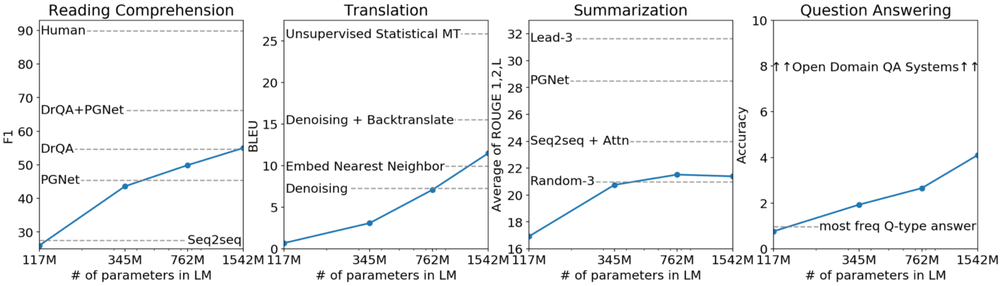
Summary of Experiments
Data Science to Patient Value (D2V)
UNIVERSITY OF COLORADO ANSCHUTZ MEDICAL CAMPUS
Notes:
Here’s a graphic summarizing their performance on some of the Experiments. They helpfully show how increasing the model size improves (at least in most cases) the result.

Slide 23
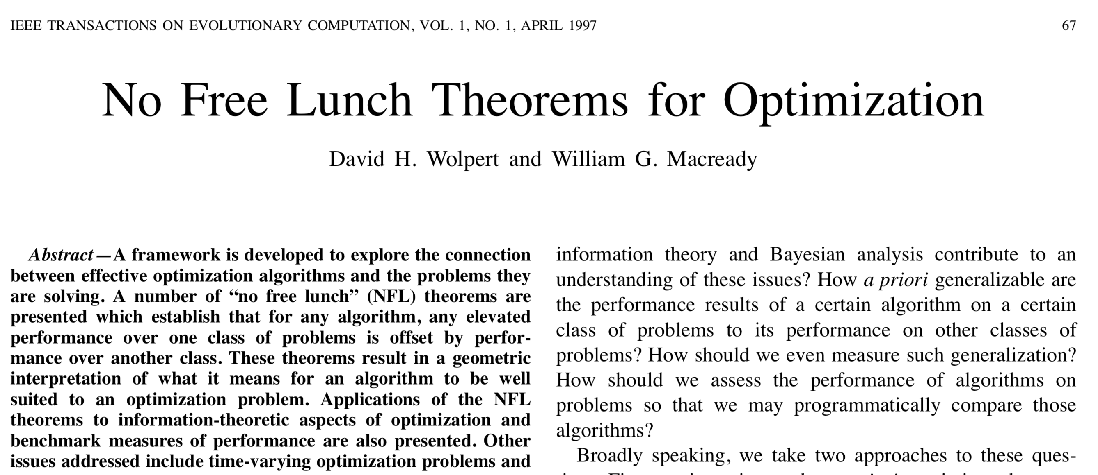
Free Lunch!?
Data Science to Patient Value (D2V)
UNIVERSITY OF COLORADO ANSCHUTZ MEDICAL CAMPUS
Notes:
I hope you’ve eaten lunch already as I’m going to spend the next few minutes talking about food.
Anyone familiar with the free lunch theorem? It comes from this 1997 paper by Wolpert and Macready.
if an algorithm performs well on a certain class of problems then it necessarily pays for that with degraded performance on the set of all remaining problems.

Slide 24
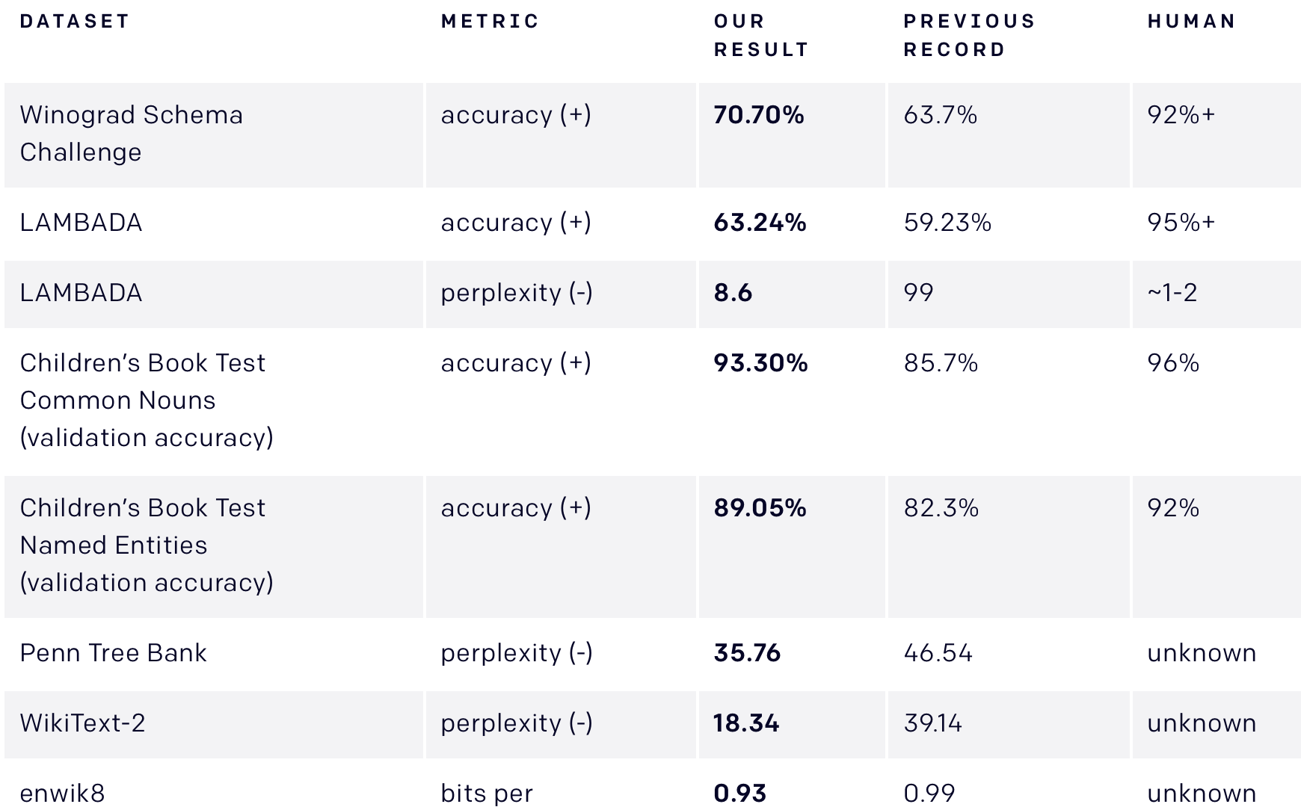
Free Lunch?
Data Science to Patient Value (D2V)
UNIVERSITY OF COLORADO ANSCHUTZ MEDICAL CAMPUS
Notes:
While OpenAI’s GPT-2 isn’t getting lunch for free. They show that the Transformer algorithm, when trained with a sufficiently large corpus for a long period of time does appear to be the best NLP algorithm.

Slide 25
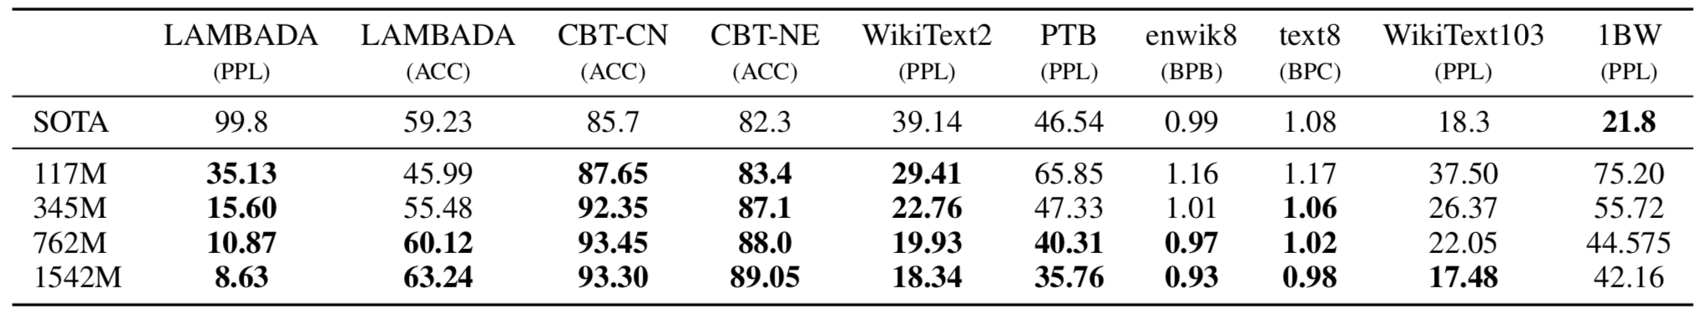
Free Lunch?
Data Science to Patient Value (D2V)
UNIVERSITY OF COLORADO ANSCHUTZ MEDICAL CAMPUS
Notes:
Again, here’s some of the results showing they’re beating state of the art by a good amount. They haven’t used this algorithm for non-NLP domain, but who knows what the result will be if someone does. Maybe they’ll be breaking into the food bank and giving out free lunches?

Slide 26
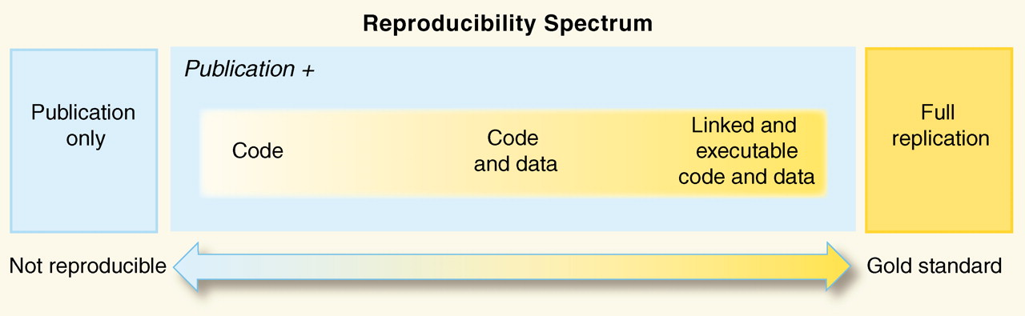
Qu’ils mangent de la brioche
Peng RD. Reproducible research in computational science. Science (New York, Ny). 2011 Dec;334(6060):1226– 1227. Available from: https://www.ncbi.nlm.nih.gov/pmc/articles/PMC3383002/
Data Science to Patient Value (D2V)
UNIVERSITY OF COLORADO ANSCHUTZ MEDICAL CAMPUS
Notes:
Reproducibility: the "ability to recompute data analytic results given an observed dataset and knowledge of the data analysis pipeline,"
Replicability: "the chance that an independent experiment targeting the same scientific question will produce a consistent result."
What does this mean for machine learning?
Sufficient detail is required such that an independent investigator could create the same hardware and software configuration, data used for all experiments, source code, documentation on data and how to run/configure software, and tests that verify the software runs correctly.

Slide 27
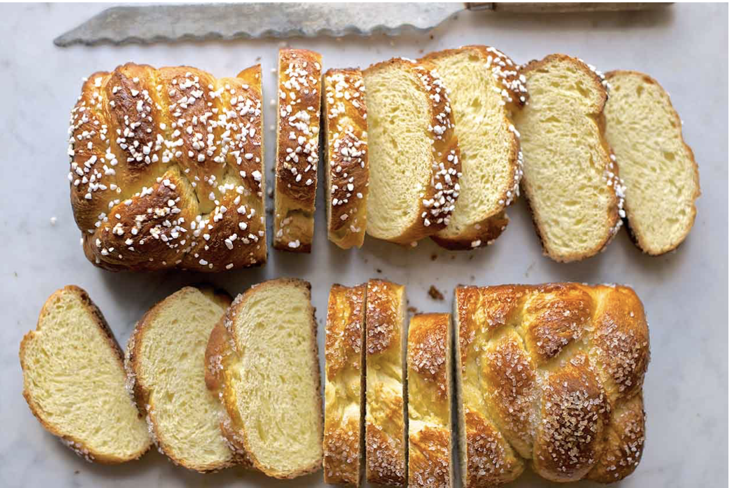
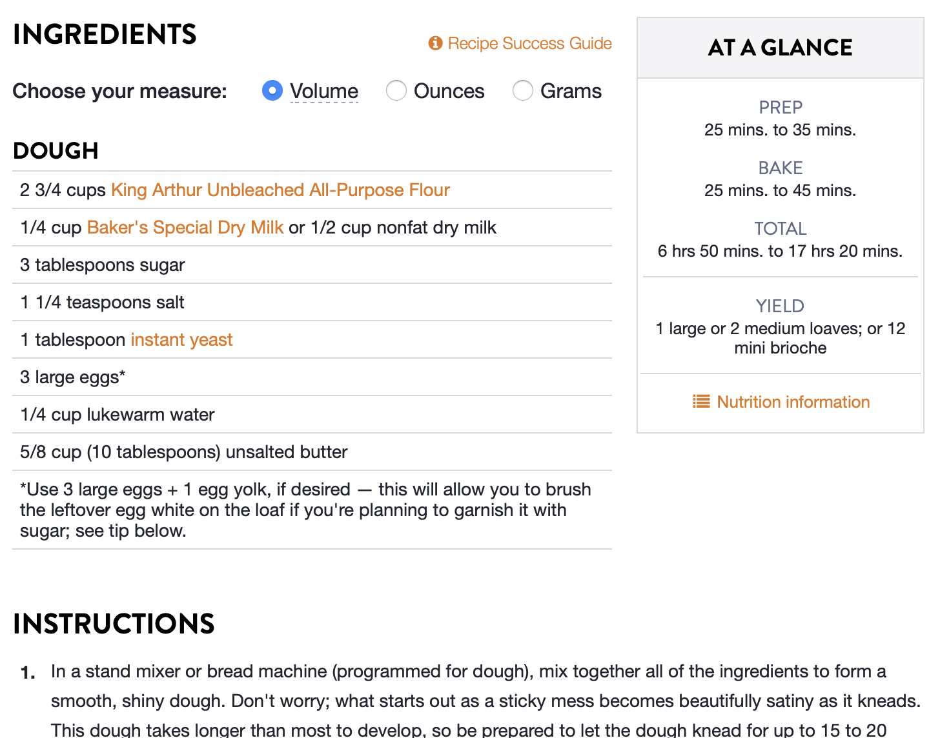
Qu’ils mangent de la brioche
https://www.kingarthurflour.com/recipes/brioche-recipe
Data Science to Patient Value (D2V)
UNIVERSITY OF COLORADO ANSCHUTZ MEDICAL CAMPUS
Notes:
Let them eat brioche – yummy French bread. You need a recipe. Just looking at the picture isn’t good enough. Reading descriptions of how yummy brioche is and how many people liked it doesn’t cut it.
Of course, baking is more than just following a recipe. So is NLP and Machine Learning. Similar to baking, you have to have a feel for when your dough it too sticky or too dry for it to turn out right. Despite all the mathematics involved, actually doing machine learning and getting a good result relies on intuition and probably a bit of random luck to succeed.

Slide 28
Qu’ils mangent de la brioche
Compute resources required & used
OpenAI Five plays 180 years worth of games against itself every day, learning via self-play. It trains using a scaled-up version of Proximal Policy Optimization running on 256 GPUs and 128,000 CPU cores
Jeremy Howard estimates $20 - $50k in compute costs to train in a month (that’s if you have everything figured out first)
Data set: “slightly over 8 million documents for a total of 40 GB of text. ”
Data Science to Patient Value (D2V)
UNIVERSITY OF COLORADO ANSCHUTZ MEDICAL CAMPUS
Notes:
So, what’s missing from their brioche recipie?
Compute resources required & used – 1 GPU, 10 GPUs?
Their previous model took 8 GPUs 1 month to train. No details have been provided on the current system. According to Jeremy Howard “One would expect that they can train their model faster by now, since they’ve had plenty of time to improve their algorithms, but on the other hand, their new model probably takes more epochs to train. Let’s assume that these two balance out, so we’re left with the difference of 10x in parameters.
If you’re in a hurry and you want to get this done in a month, then you’re going to need 80 GPUs. You can grab a server with 8 GPUs from the AWS spot market for $7.34/hour. That’s around $5300 for a month. You’ll need ten of these servers, so that’s around $50k to train the model in a month. OpenAI have made their code available, and described how to create the necessary dataset, but in practice there’s still going to be plenty of trial and error, so in practice it might cost twice as much.
If you buy your GPUs, you might get that cost as low as $20k
Data set: “slightly over 8 million documents for a total of 40 GB of text. ”
2 paragraphs describe their WebText data set with no accompanying code. Items mentioned are use of content extractors, de-duplication, and “some heuristic based cleaning.” Also mentioned is removal of all Wikipedia documents.
Data set is not available to my knowledge, though users have created clones based on the brief description in the paper. However, details are severely lacking
Human filtered links based on reddit karma… Why did they pick 3 karma? What evidence do they have that it was a valid selection
Removed non-English webpages from text. How? Why?

Slide 29
Qu’ils mangent de la brioche
Specifics on training to build model
Samples reviewed to get examples shown
Ambiguous language without full source code: “No lossy pre-processing nor tokenization” what does this mean?
Data Science to Patient Value (D2V)
UNIVERSITY OF COLORADO ANSCHUTZ MEDICAL CAMPUS
Notes:
Specifics on training to build model. For details on the model you have to read their previous paper to get details
Samples reviewed to get examples shown. I played around with the small model available for a few hours and there are a lot of parameters to adjust. With trying different random starting seeds, you can get some pretty amazing stuff or complete junk.
Ambiguous language without full source code: “No lossy pre-processing nor tokenization” what does this mean?

Slide 30
OpenAI GPT-2 In the Press
https://www.theverge.com/2019/2/14/18224704/ai-machine-learning-language-models-read-write-openai-gpt2
https://slate.com/technology/2019/02/openai-gpt2-text-generating-algorithm-ai-dangerous.html
https://techcrunch.com/2019/02/17/openai-text-generator-dangerous/
https://venturebeat.com/2019/02/14/openai-let-us-generate-text-with-an-ai-model-that-achieves-state-of-the-art-performance-in-several-nlp-tasks/
https://www.theguardian.com/commentisfree/2019/feb/15/ai-write-robot-openai-gpt2-elon-musk
https://www.theguardian.com/technology/2019/feb/14/elon-musk-backed-ai-writes-convincing-news-fiction
https://arstechnica.com/information-technology/2019/02/researchers-scared-by-their-own-work-hold-back-deepfakes-for-text-ai/
https://medium.com/syncedreview/openai-guards-its-ml-model-code-data-to-thwart-malicious-usage-d9f7e9c43cd0
https://www.vox.com/future-perfect/2019/2/14/18222270/artificial-intelligence-open-ai-natural-language-processing
Plus twitter, reddit, etc.
… And more
Data Science to Patient Value (D2V)
UNIVERSITY OF COLORADO ANSCHUTZ MEDICAL CAMPUS
Notes:
One of the aspects of this paper that upset people the most – at least academics and other machine learning practitioners is the public relations campaign.
<click through>

Slide 31
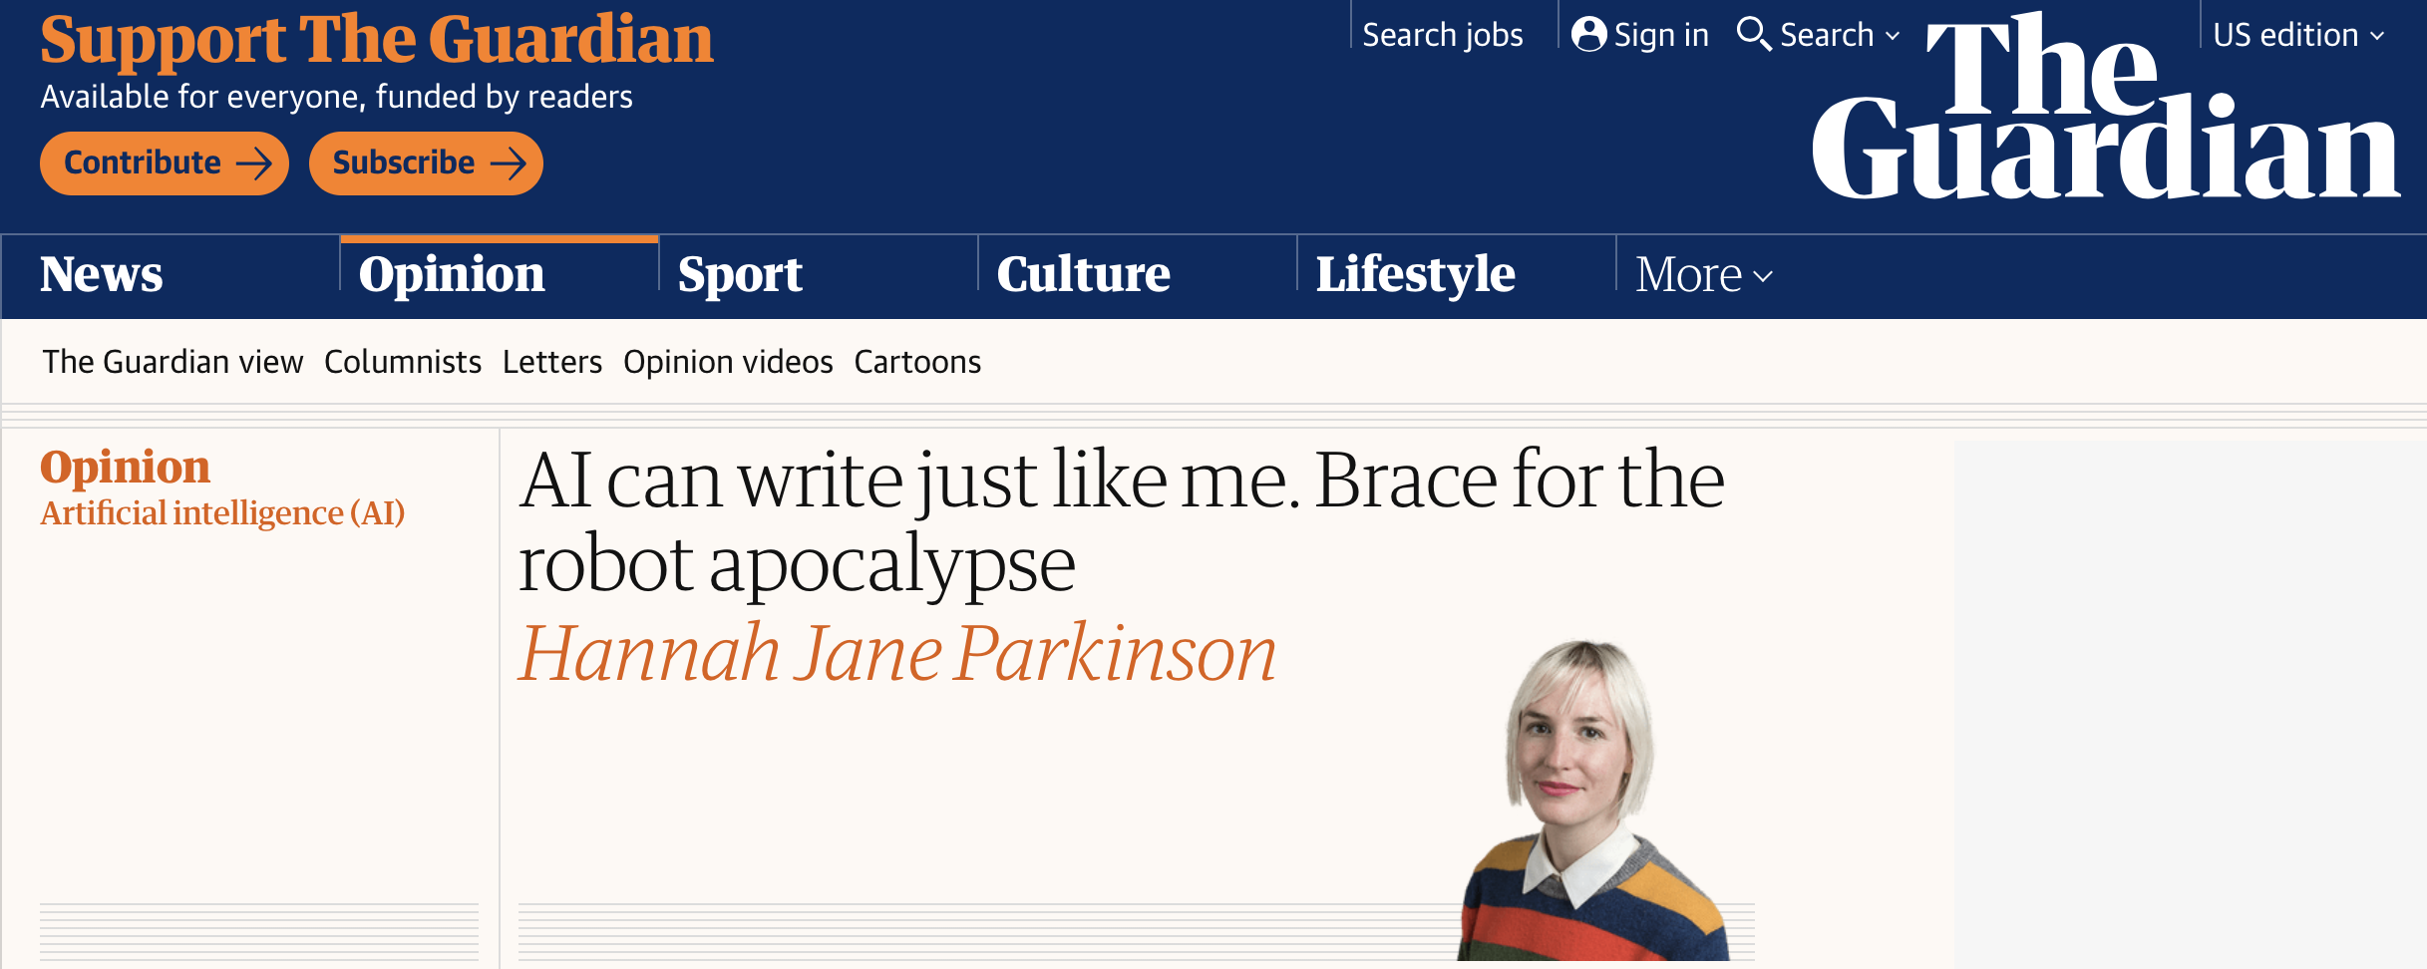
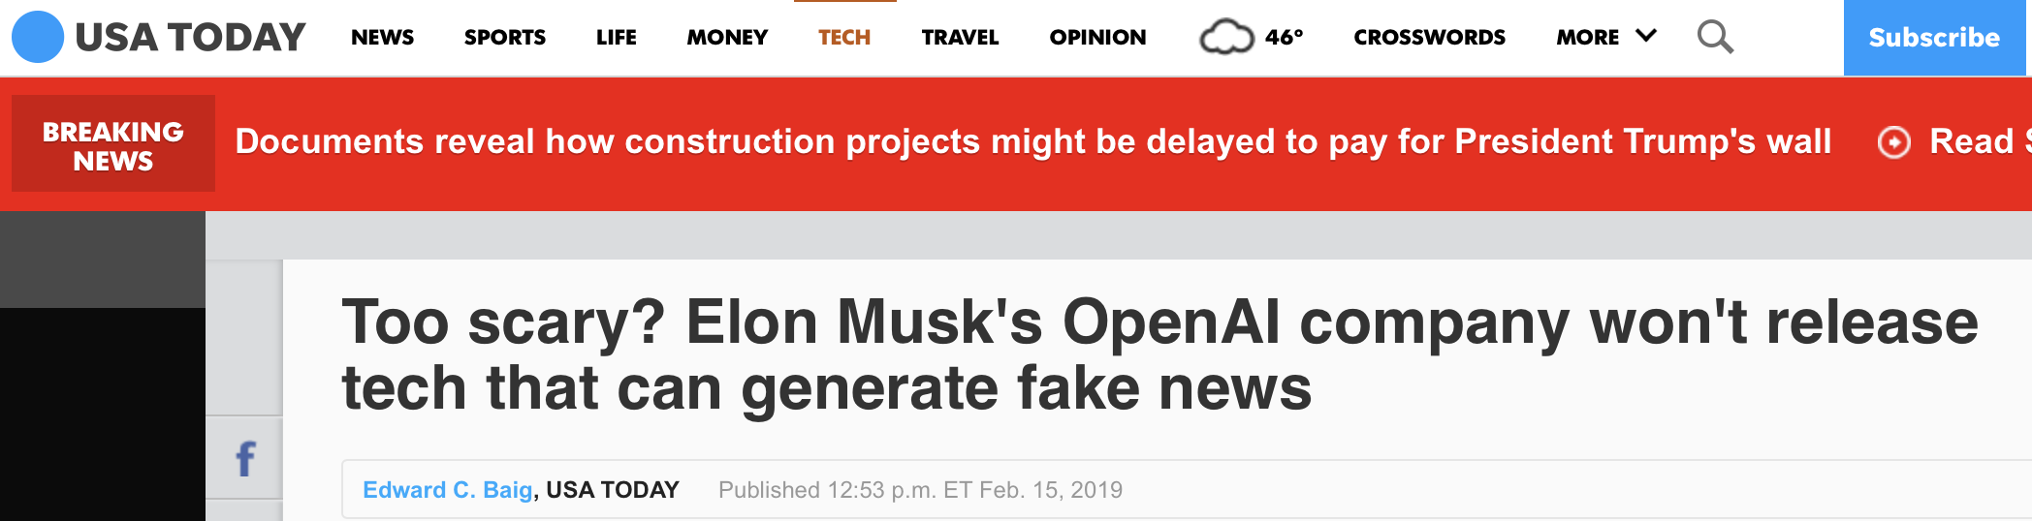
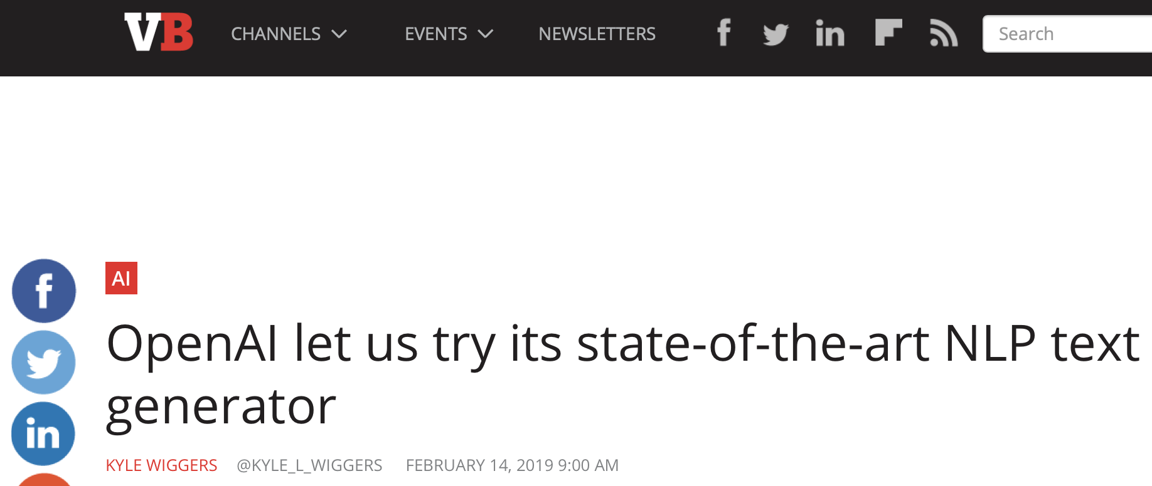
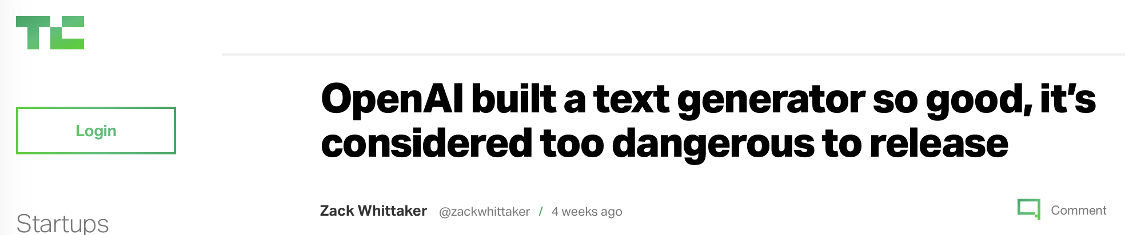
OpenAI GPT-2 In the Press
Data Science to Patient Value (D2V)
UNIVERSITY OF COLORADO ANSCHUTZ MEDICAL CAMPUS
Notes:
Here’s a brief look at some of the sensational headlines.

Slide 32
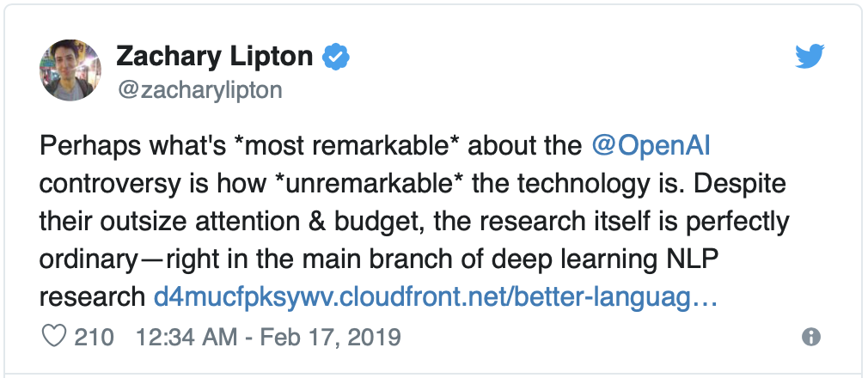
OpenAI GPT-2 In the Press
Data Science to Patient Value (D2V)
UNIVERSITY OF COLORADO ANSCHUTZ MEDICAL CAMPUS
Notes:
Zack – Assistant Professor at Carnegie Melon University

Slide 33
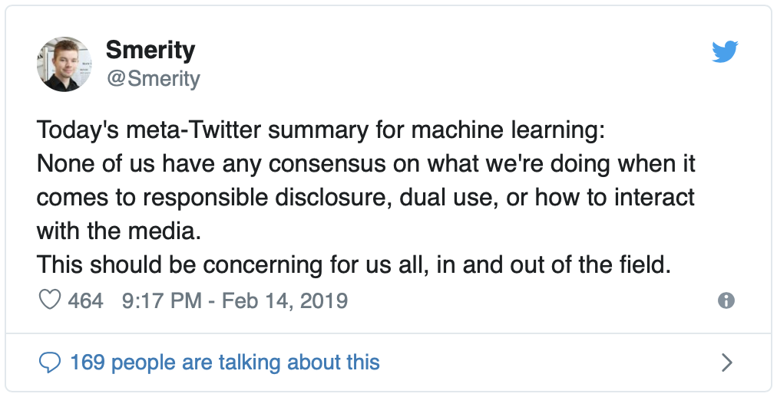
Ethics
Data Science to Patient Value (D2V)
UNIVERSITY OF COLORADO ANSCHUTZ MEDICAL CAMPUS
Notes:
This guy’s tweet was selected as the poster child and summary for some of the arguments by Skynettoday.com:

Slide 34
Ethics
Policymakers should collaborate closely with technical researchers to investigate, prevent, and mitigate potential malicious uses of AI.
Researchers and engineers in artificial intelligence should take the dual-use nature of their work seriously, allowing misuse- related considerations to influence research priorities and norms, and proactively reaching out to relevant actors when harmful applications are foreseeable.
Best practices should be identified in research areas with more mature methods for addressing dual-use concerns, such as computer security, and imported where applicable to the case of AI.
Actively seek to expand the range of stakeholders and domain experts involved in discussions of these challenges.
The Malicious Use of Artificial Intelligence: Forecasting, Prevention, and Mitigation https://maliciousaireport.com
Data Science to Patient Value (D2V)
UNIVERSITY OF COLORADO ANSCHUTZ MEDICAL CAMPUS
Notes:
The ethics of machine learning needs to be taken seriously. A report on by a group of people from institutions ranging from
Future of Humanity Institute
University of Oxford
Electronic Frontier Foundation
And others
came to these 4 recommendations for preventing malicious use of AI:
<click through>

Slide 35
Ethics
The most serious threats are most likely to come from folks with resources to spend $100k or so on (for example) a disinformation campaign to attempt to change the outcome of a democratic election. In practice, the most likely exploit is (in my opinion) a foreign power spending that money to dramatically escalate existing disinformation campaigns, such as those that have been extensively documented by the US intelligence community.
The only practical defense against such an attack is (as far as I can tell) to use the same tools to both attempt to identify, and push back against, such disinformation. These kinds of defenses are likely to be much more powerful when wielded by the broader community of those impacted. The power of a large group of individuals has repeatedly been shown to be more powerful at creating, than at destruction, as we see in projects such as Wikipedia, or open source software.
Some thoughts on zero-day threats in AI, and OpenAI's GP2 https://www.fast.ai/2019/02/15/openai-gp2/
Data Science to Patient Value (D2V)
UNIVERSITY OF COLORADO ANSCHUTZ MEDICAL CAMPUS

Slide 36
Ethics
By releasing the model, this malicious use will happen sooner. But by not releasing the model, there will be fewer defenses available and less real understanding of the issues from those that are impacted. Those both sound like bad outcomes to me.
Some thoughts on zero-day threats in AI, and OpenAI's GP2 https://www.fast.ai/2019/02/15/openai-gp2/
Data Science to Patient Value (D2V)
UNIVERSITY OF COLORADO ANSCHUTZ MEDICAL CAMPUS

Slide 37

Demo
GPT-2 117M model
Data Science to Patient Value (D2V)
UNIVERSITY OF COLORADO ANSCHUTZ MEDICAL CAMPUS

Slide 38
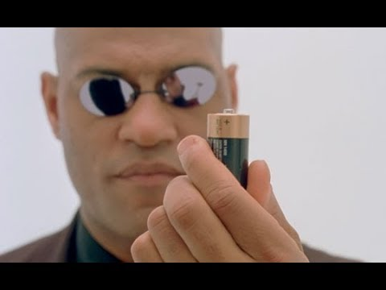
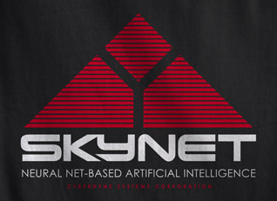
What does this mean?
Data Science to Patient Value (D2V)
UNIVERSITY OF COLORADO ANSCHUTZ MEDICAL CAMPUS
Notes:
So, what does this all mean?
<click>
Does it mean that Skynet is here and we’re all going to be running for our lives soon?
<click>
Does it mean we’re gong to be trapped in the Matrix and turned in to batteries?
From reading the headlines about the new GPT-2 model, you might believe that the world is coming to an end.
I think that the result is going to be something more positive than these science fiction doomsday prophecies. Yes, people can create more fake news – though that’s been happening just fine before GPT-2 was created.

Slide 39
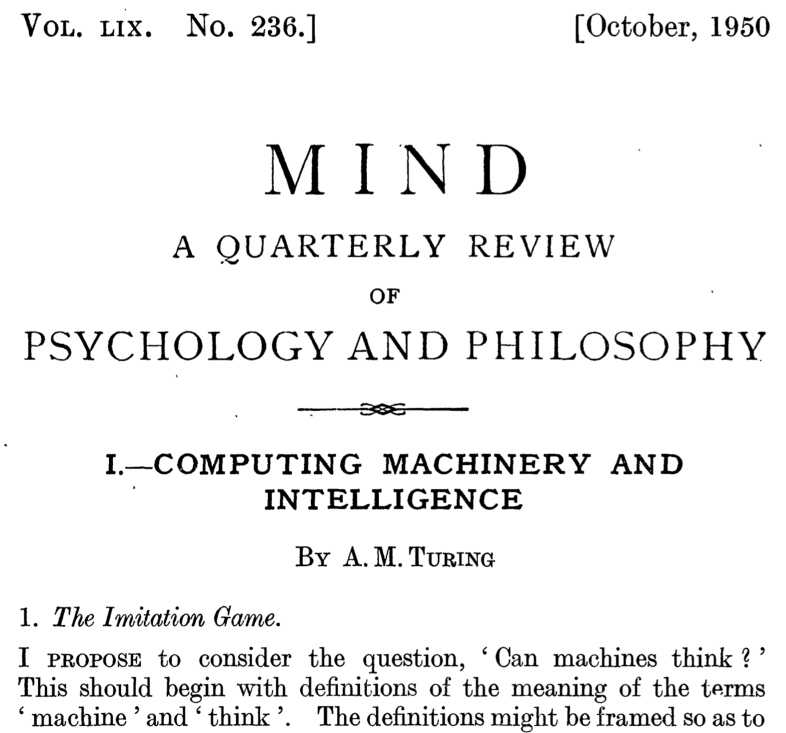
Notes:
The idea that computers can think isn’t a useful question. The useful question is “Can computers automatically make a decision that is beneficial in medicine, finance, language, or any other field?”
The great philosophical treatise by Mr. Turing discusses what does it mean to think and how to judge the difference between two entities. He proposes an imitation game initially where two people, 1 male and 1 female are hidden from an observer. The observer may ask each of them questions until the observer can decide which is the male and which is the female. This imitation game could be followed with a computer and a human as the hidden players and the observer must decide which is human and which is a computer. The question ”can machines think?" should be replaced by "Are there imaginable digital computers which would do well in the imitation game?"

Slide 40
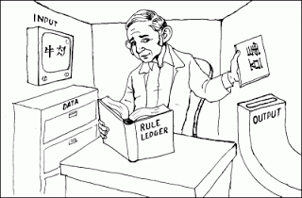
The Chinese Room
Searle JR. Minds, brains, and programs. Behavioral and Brain Sciences. 1980 Sep;3(3):417–24. Available from: https://www.cambridge.org/core/journals/behavioral-and-brain-sciences/article/minds-brains-and-programs/DC644B47A4299C637C89772FACC2706A
Data Science to Patient Value (D2V)
UNIVERSITY OF COLORADO ANSCHUTZ MEDICAL CAMPUS
Notes:
In the Natural Language processing space, an update to the Imitation Game is called the Chinese Room
Imagine a native English speaker who knows no Chinese locked in a room full of boxes of Chinese symbols (a data base) together with a book of instructions for manipulating the symbols (the program). Imagine that people outside the room send in other Chinese symbols which, unknown to the person in the room, are questions in Chinese (the input). And imagine that by following the instructions in the program the man in the room is able to pass out Chinese symbols which are correct answers to the questions (the output). The program enables the person in the room to pass the Turing Test for understanding Chinese but he does not understand a word of Chinese.
Understanding is over rated – its not necessary as long as you get the answer right. To solve problems any field, we don’t care if software can think – If the end result is that we have a software program that can solve problems and improve our ability to accomplish a task, that’s good enough.

Slide 41
References
“Language Models are Unsupervised Multitask Learners” https://d4mucfpksywv.cloudfront.net/better-language-models/language-models.pdf
Announcement blog post by OpenAI: https://blog.openai.com/better-language-models/
Github repository: https://github.com/openai/gpt-2
Previous work – Finetuned Transformer LM - (aka GPT-1)
“Improving Language Understanding by Generative Pre-Training” https://s3-us-west-2.amazonaws.com/openai-assets/research-covers/language-unsupervised/language_understanding_paper.pdf
Announcement blog post: https://openai.com/blog/language-unsupervised/
Data Science to Patient Value (D2V)
UNIVERSITY OF COLORADO ANSCHUTZ MEDICAL CAMPUS

Slide 42
References
https://www.skynettoday.com/briefs/gpt2
Data Science to Patient Value (D2V)
UNIVERSITY OF COLORADO ANSCHUTZ MEDICAL CAMPUS

Slide 43
Questions
seth.russell@ucdenver.edu
Data Science to Patient Value (D2V)
UNIVERSITY OF COLORADO ANSCHUTZ MEDICAL CAMPUS

Slide 44
Useful URLs
https://github.com/eukaryote31/openwebtext
Data Science to Patient Value (D2V)
UNIVERSITY OF COLORADO ANSCHUTZ MEDICAL CAMPUS

Slide 45
Multitask Learning (include this?)
Learning is very slow
Attempting to learn multiple tasks at once
Data Science to Patient Value (D2V)
UNIVERSITY OF COLORADO ANSCHUTZ MEDICAL CAMPUS

Slide 46
Title
Data Science to Patient Value (D2V)
UNIVERSITY OF COLORADO ANSCHUTZ MEDICAL CAMPUS

